Slide 1
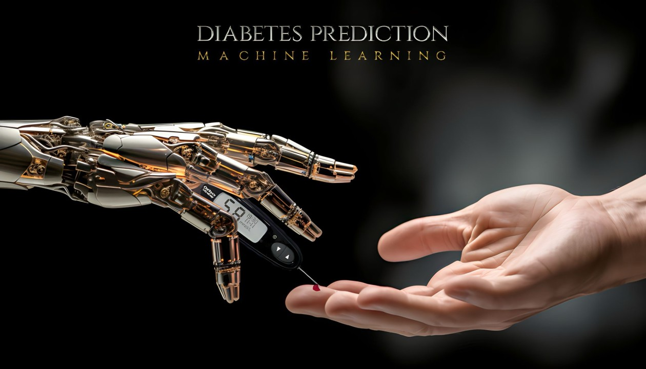
DIABETES PREDICTION
M A C H I N E L E A R N I N G

Slide 2


Shivasharane Akkamahadevi
Government Women’s Polytechnic
Shiralakoppa
Project Seminar On
“Diabetes Prediction Using Machine Learning ”
Under the Guidance of :
Presented By :
Priya M K
Lecturer, Department of CS&E,
Shivasharane Akkamahadevi Government
Women’s Polytechnic Shiralakoppa.
Bhoomika N G

Slide 3
01.
Abstract
02.
Introduction
03.
Existing System
04.
Proposed System
Table of
Contents
05.
Requirements
06.
Literature Survey
07.
Methodology
08.
Result
09.
Conclusion
10.
Reference
Notes:
i

Slide 4
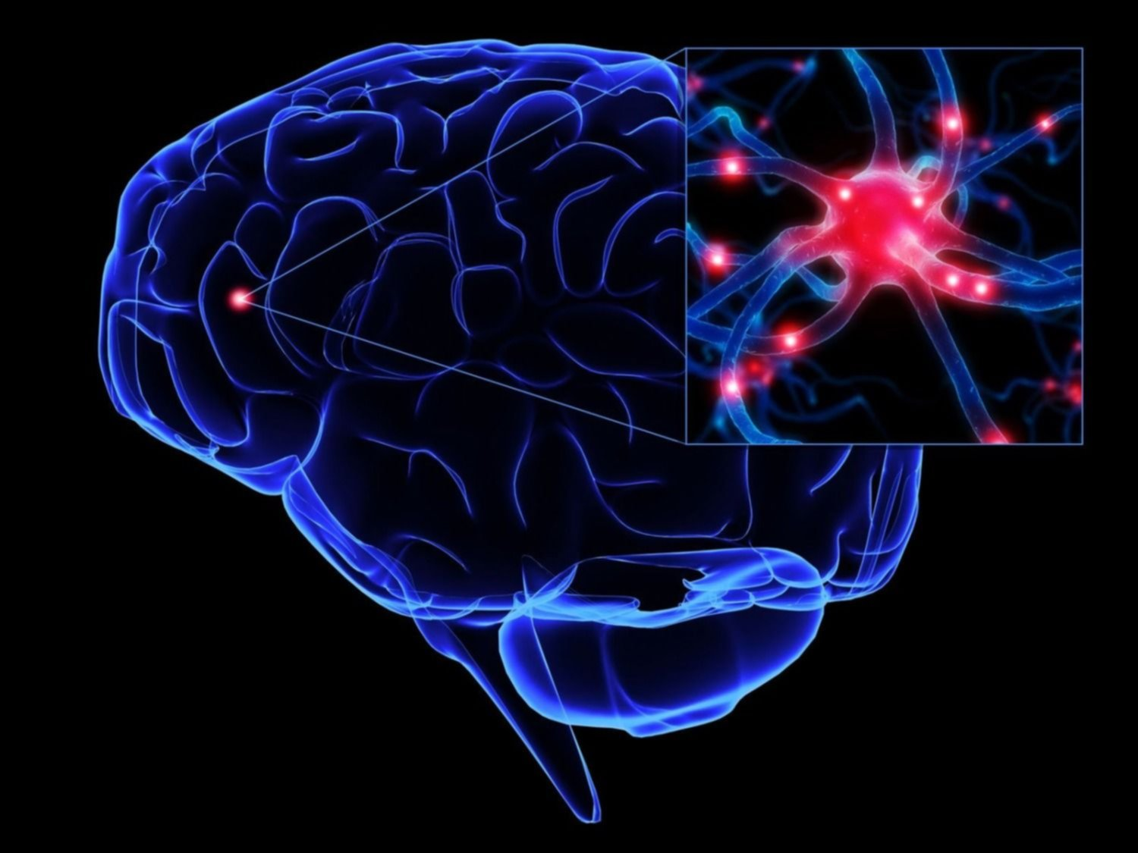
Diabetes prediction employs demographic data, medical history, and lifestyle habits to forecast the likelihood of developing the condition.
Advanced machine learning models analyze these factors, aiding in early detection and intervention.
This proactive approach empowers individuals and healthcare providers to manage and potentially prevent diabetes.
Abstract
01.
Diabetes Prediction
Notes:
i

Slide 5

Diabetes mellitus, commonly referred to as diabetes, is a chronic metabolic disorder characterized by elevated blood sugar levels resulting from defects in insulin secretion, insulin action, or both.
This project aims to develop and evaluate machine learning models for predicting the onset of diabetes in individuals based on a range of demographic, clinical, and lifestyle factors.
With advancements in machine learning techniques and the availability of large-scale health care datasets.
Introduction
02.
Diabetes Prediction
Notes:
.[‘;]ol;.-0ll’il0p-

Slide 6


Problem
Statement
03.
The problem statement in diabetes prediction involves defining the objective of accurately identifying individuals at risk of developing diabetes using data-driven approaches.
The ultimate goal is to improve healthcare outcomes by enabling proactive measures for diabetes management and prevention.

Slide 7

Objectives
04.
To Gather and preprocess diverse health data to establish a comprehensive foundation for model development.
To preprocess the dataset, addressing issues such as missing values, feature scaling, and categorical variable encoding, to prepare it for model training.
To evaluate the predictive models using appropriate evaluation metrics and techniques, such as accuracy, precision, recall, F1 score, and receiver operating characteristic (ROC) curve analysis.
To develop a user-friendly application or web interface for deploying the best-performing predictive model.

Slide 8

Existing System
05.
Existing many research handled for diabetes detection. Data mining approach like clustering, classification were studied in existing system.
Diabetes prediction using algorithms such as k-Nearest Neighbour (K-NN), k-means , branch and bound algorithm was proposed, A basic diabetic dataset is chosen for carrying out the comparative analysis.

Slide 9
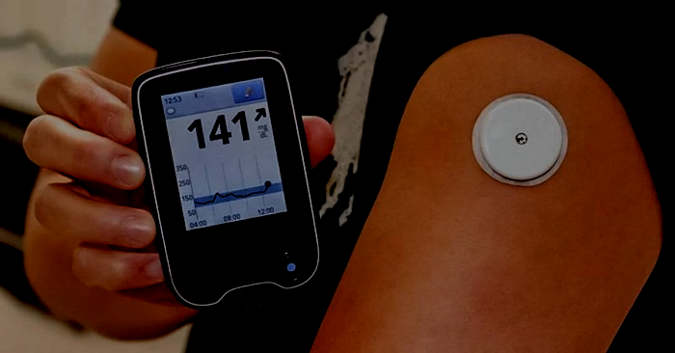
Proposed System
06.
This study proposes classifying a local diabetes dataset as a binary classification problem using machine learning algorithms. Specifically, algorithms such as Random Forest, Logistic Regression, and Support Vector Machine (SVM) are considered for this task.
The proposed system aims to develop a predictive model for diabetes detection using machine learning techniques implemented in Python.

Slide 10

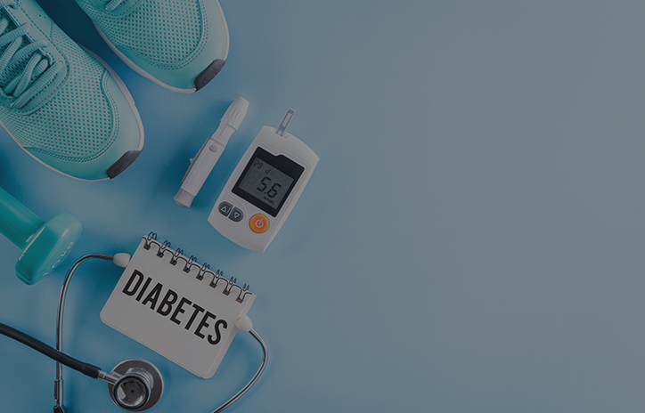

Requirements
07.
Hardware Requirements:
Software Requirements:
Processor : Any Processor above 500 MHz
RAM : 4GB
Hard Disk : 500GB
Input device : Standard keyboard and mouse.
Output device monitor : VGA with High Resolution
Operating System : Windows 10
Programming : Python 3.12 and related libraries
IDE : Jupyter Notebook

Slide 11
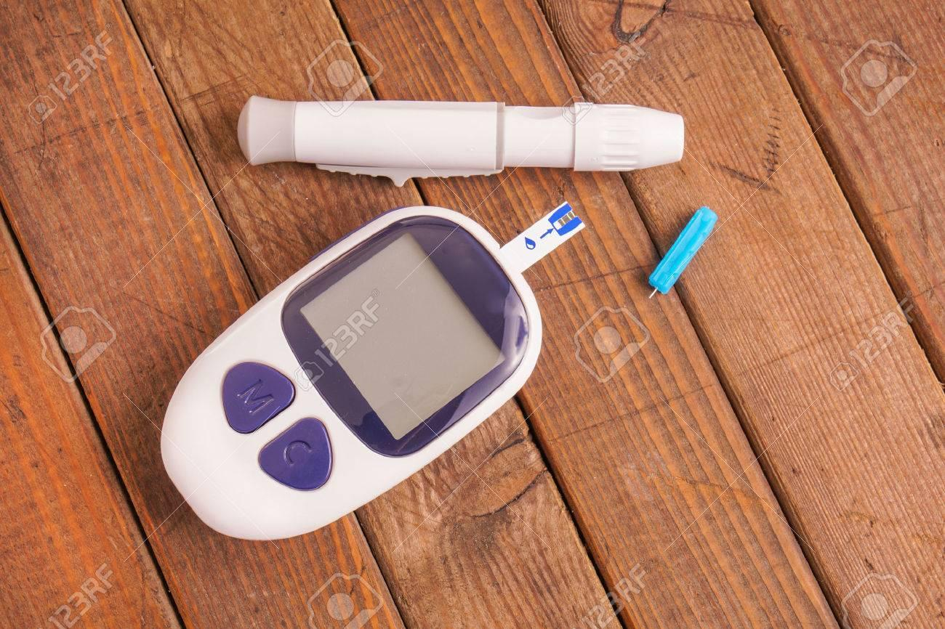

08.
Literacy Survey
09.
Literacy Serve
Citation | Authors | Methods | Results | Dataset
The institution of engineering and technology-2022 Bangladesh | Isfafuzzaman Tasin, Riasat Khan | XGBoost Classifier | Accuracy:- 88.5 Precision:- 0.81 | Pima Indian dataset
International Research Journal of Modernization in Engineering Technology and Science-2022 Andra Pradesh | M. Ramakrishna Murthy, M. Manoj Kumar, | Random Forest, Decision tree and Naïve Bayes. | Random forest Accuracy:-84.4 Precision:- 50.8 Decision tree Accuracy:-77.9 Precision:- 31.4 Naïve Bayes Accuracy:-76.3 Precision:- 34.2 | Diabetes Health Indicators Dataset
Diabetes Prediction Using Machine Learning Algorithm and Onthology, Morocco University-2022 | Hakim El Massari, Zineb Sabouri | SVM, Logistic Regression. | SVM Accuracy:-77.0 Precision:- 78.0 LR Accuracy:-77.0 Precision:- 79.0 | Pima Indian dataset

Slide 12
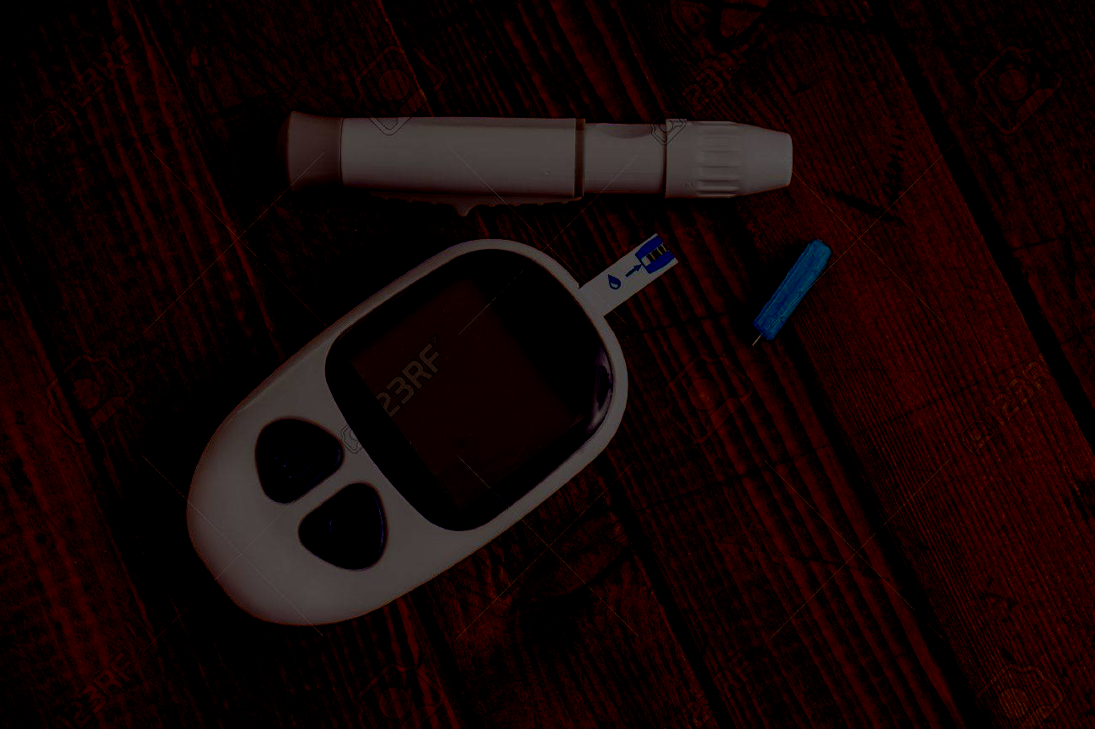
09.
Data Collection
Methodology
Data Pre-
processing
Data Splitting
Exploratory data
Analysis(EDA)
Training Data
Testing Data
Training Model
1.Logistic Regression
2.Random Forest
3.SVM
Evaluation Method
1.Accuracy
2.Precision
3.Recall
Notes:
i

Slide 13
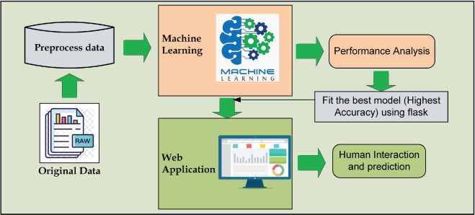
10.
Implementation

Slide 14
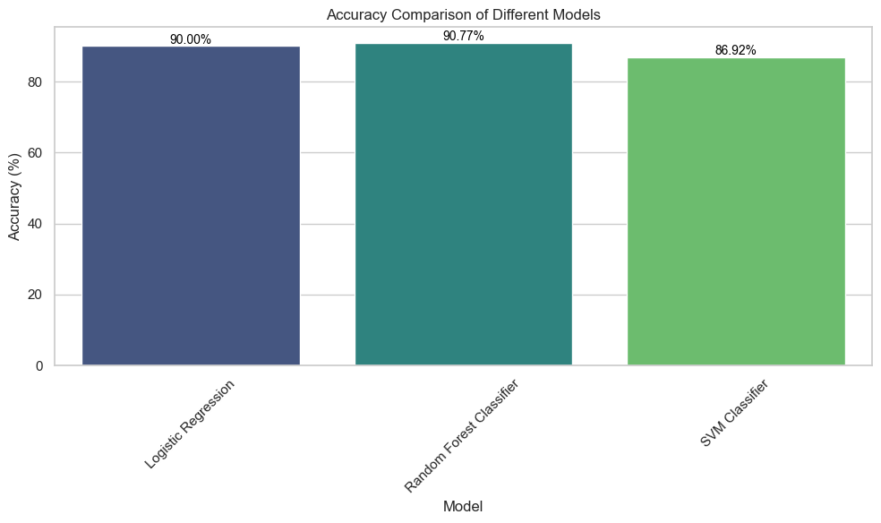

Slide 15
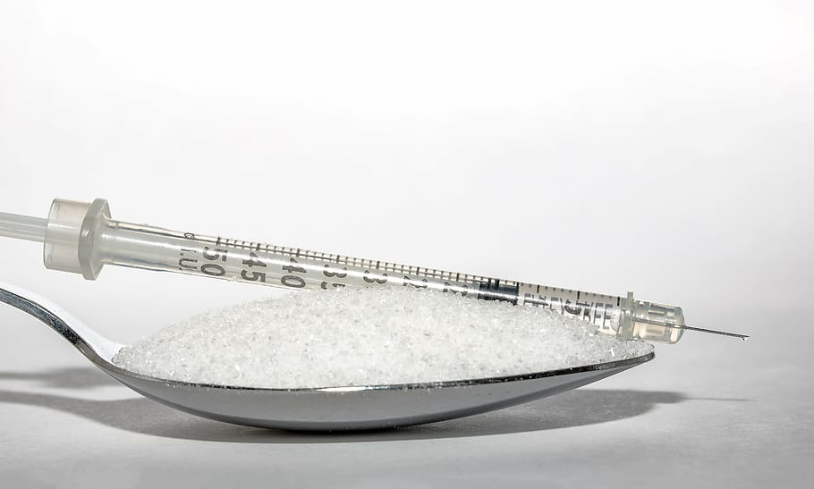

Home Screen
Result/Output

Slide 16
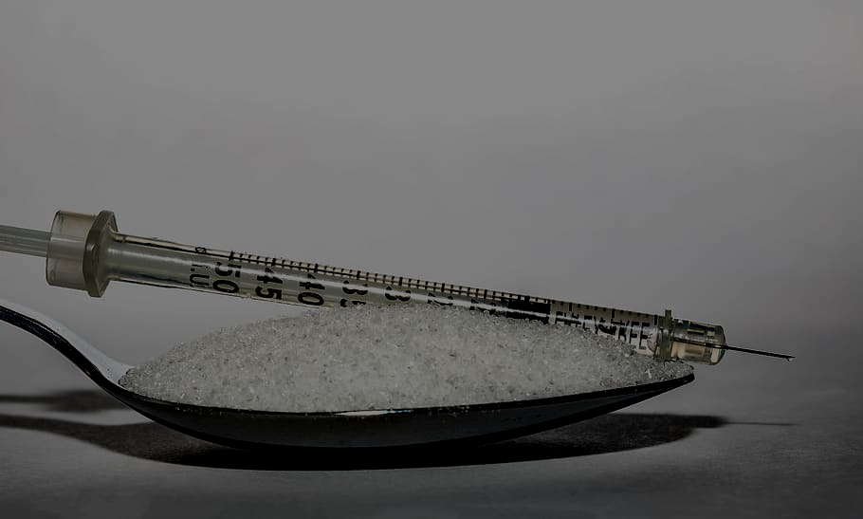
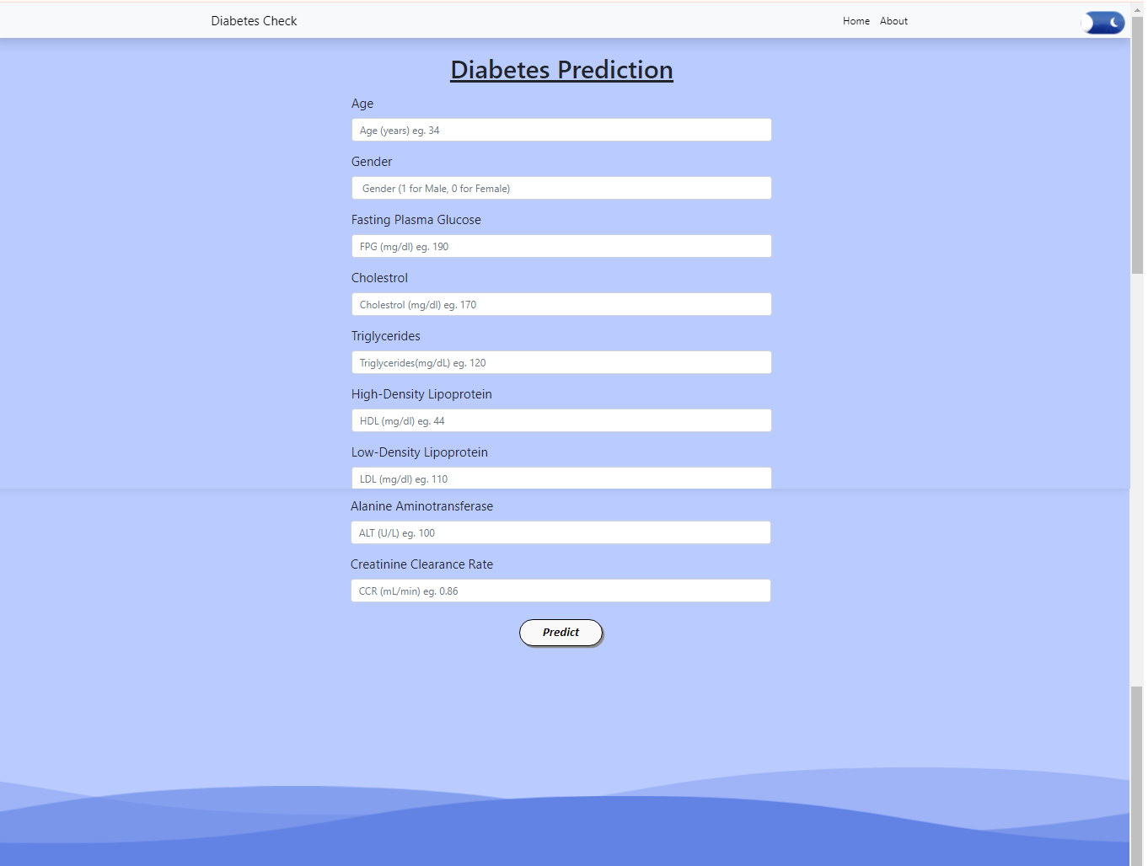
User Input
Click th

Slide 17
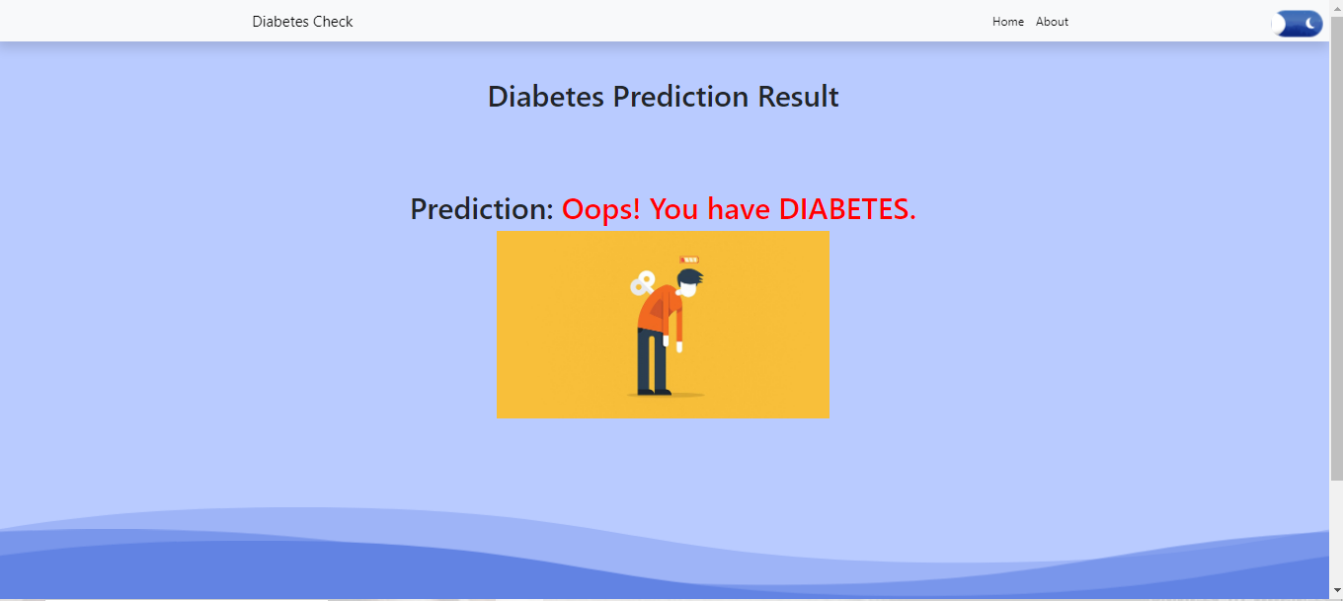
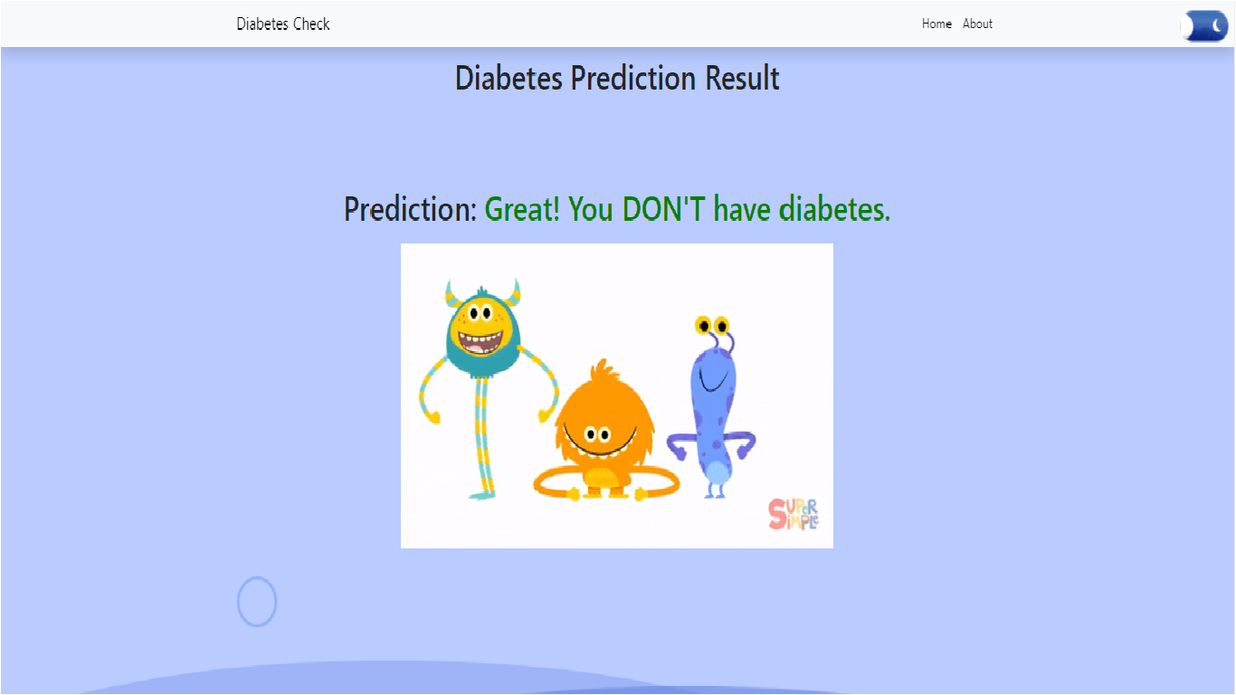

Positive Output
Click th
Negative Output

Slide 18
10.
Future Enhancement
In the future, advancements in machine learning for diabetes prediction are likely to focus on increasing the accuracy and personalization of predictive models. This could involve integrating additional data sources such as genetic information, microbiome data, and social determinants of health. Furthermore, advancements in model interpretability and transparency will be crucial for gaining insights into the underlying factors driving predictions and for building trust among healthcare providers and patients. Additionally, the development of user-friendly interfaces and integration with wearable devices could enable seamless monitoring and intervention, ultimately leading to more effective prevention and management strategies for diabetes.

Slide 19
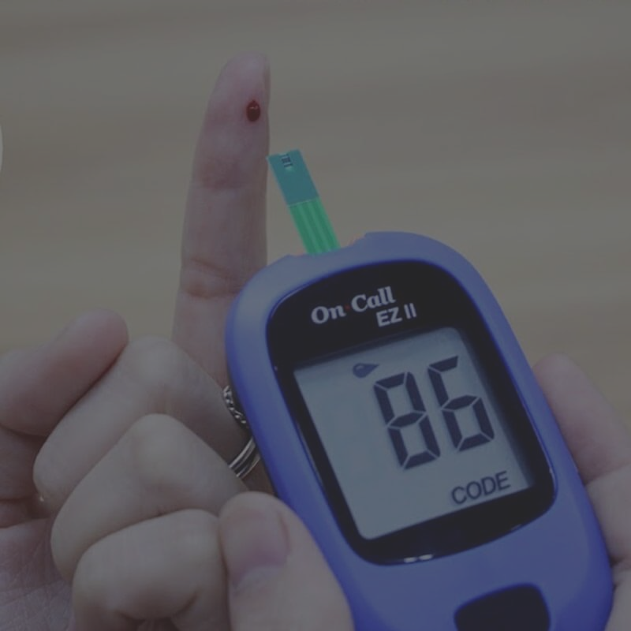

11.
Conclusion
The overall aim to develop and evaluate machine learning models for the classification of diabetes prediction. The goal of this project is to design accurate and efficient model by applying lesser number of attributes and tests. Firstly, the data is pre-processed and then it is used in the model. Logistic Regression with 90% and Random Forest classifier with approximately 90% are the most efficient classification algorithms. Our project using some various machine learning algorithms namely Logistic Regression , Random Forest Classifier , SVM, on datasets to predict diabetes.

Slide 20

Reference
12.
https://chat.openai.com
https://bard.google.com/chat
https://www.kaggle.com
https://www.w3schools.com/
https://github.com/
https://sci-hub.se/
https://www.ncbi.nlm.nih.gov/pmc/articles/PMC10107388/
https://www.analyticsvidhya.com/blog/2022/01/diabetes-prediction- using-machine-learning
https://www.ncbi.nlm.nih.gov/pmc/articles/PMC10107388/

Slide 21

According to a 2023 government study, 11% of India's population has diabetes, which is 101 million people. This is 36% more than the 2021 estimate of 74.2 million people by the International Diabetes Federation (IDF). The study also found that 15% of Indians are pre-diabetic and 35% have hypertension.
India has the second largest diabetes epidemic in the world, after China. 77 million people in India have diabetes, including 12.1 million people over 65 years old. The IDF estimates that this number will increase to 10.4% by 2030.
The Indian government says that unhealthy diets, lack of physical activity, and harmful use of alcohol are factors in the high rate of diabetes in India.

